Slide 1
Full-Stack E-commerce Web Application
Seamless Shopping Experience Powered by ASP.NET Core & Stripe
Built with ASP.NET Core, Entity Framework, Stripe Payments
Notes:
This slide introduces the topic of our presentation - a full-stack e-commerce web application built with ASP.NET Core and Stripe. We'll be discussing how we leveraged these technologies to create a seamless shopping experience for our customers. Key components include ASP.NET Core for the web application, Entity Framework for data management, and Stripe for secure online payments. The goal is to highlight how these powerful tools can be combined to build a robust and feature-rich e-commerce platform.

Slide 2
👨‍💻Meet Our Team
We are a passionate group of students from the Faculty of Engineering, specializing in Communication and Computer Engineering. Discover the talent and dedication behind our innovative projects and collaborative efforts.
👥 Team Members:
1
Abanoub Sami
2
Abanoub Adel
3
Kerolos Hani Salama
4
Mina Gamil Halim

Slide 3



💡 Project Idea
🛒 A full-featured online shopping platform

Slide 4
🛠️ Admin Features
Manage products & categories
Handle orders
Handle Companies & users.
Control access via roles

Slide 5
👤 Customer Features
Browse products
Add items to a shopping cart
Place orders through a secure checkout process

Slide 6
💻 Technologies Used
⚙️ ASP.NET Core
🧩 Razor Pages
🗄️ Entity Framework Core
🖥️ Visual Studio
🛠️ C#
🐘 SQL Server
🌐 HTML / CSS / JavaScript
📦 Stripe API

Slide 7




👥 User Roles
Admin
Customer
Manage products, categories, companies, users, and orders
Browse products, add to cart, place orders, and view order history
Company
Employee
Customers with special access and pricing options
Assist in order processing, customer support, and managing daily operations

Slide 8
Services Provided
1
2
3
Product Catalog
Shopping Cart
Order Placement
with filtering options, Search functionality to quickly find products
Manage shopping cart add, remove, update items
Tracking orders for customers

Slide 9





Services Provided
User Authentication
with role-based access control
Admin Dashboard
For managing products, orders, and users
Company users
Have access to more features than regular customers
Stripe Payment Integration
For secure online payments
Facebook Authentication
Added for quick and secure user registration

Slide 10
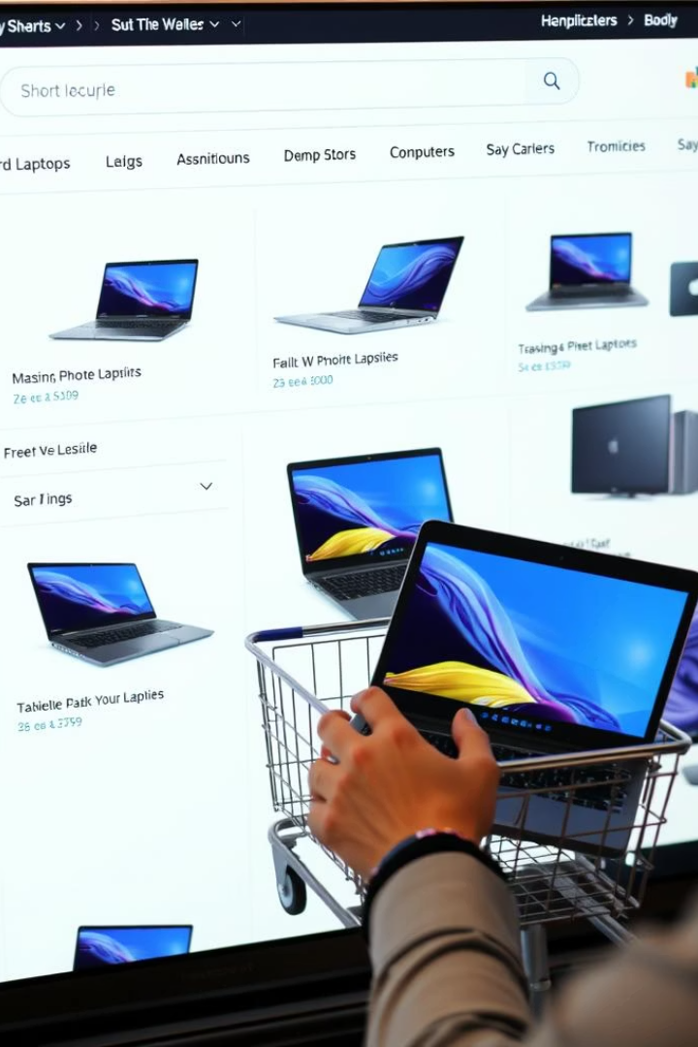
Customer Shopping Experience
Browse products by categories and images
Add or remove items from the cart
Smooth checkout with Stripe payment gateway
Flow: Home → Product Details → Cart → Checkout → Confirmation

Slide 11
Shopping Cart System
1
Increment/decrement product quantities
2
Session tracking for cart persistence
3
Real-time updates without page reloads

Slide 12
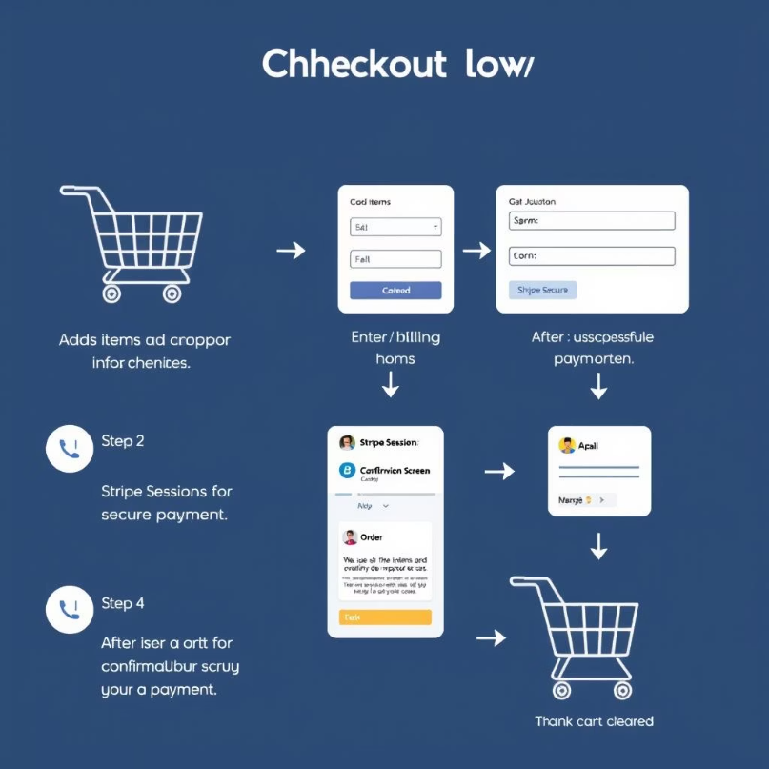
Checkout & Payment Integration
Collect shipping and billing info
Use Stripe Sessions for secure payment
Confirm order and clear cart after payment

Slide 13

User Authentication & Authorization
🧑‍💼 Extended User Profile Extra info like address, city, postal code, and company linked to each user
🛡️ Role-Based Access Control Different permissions for Admin, Customer, Employee, and Company roles
📝 Customized Authentication Pages Tailored login and registration UI using Identity scaffolding
🔒 Secure Checkout Only logged-in users can place orders to keep transactions safe

Slide 14






Behind the Scenes
SQL Server database managing shopping carts, orders, products
Unit of Work pattern to handle database transactions
Dynamic pricing with discounts

Slide 15
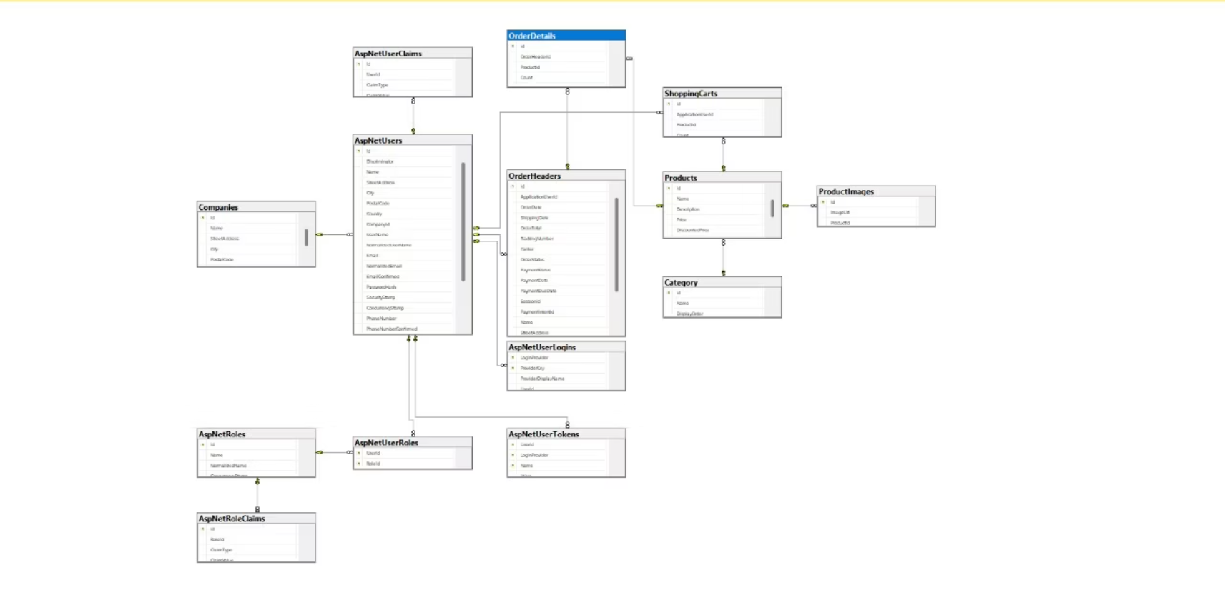
ERD(Code First)

Slide 16
Future Improvements
Make the website responsive
Wishlist model that the user can save favorite products
Email confirmation to notify the user of each action they do
The capability of editing the information of the user like postal code, address,…

Slide 17
Thank You

